Slide 1
Examination Timetabling Automation using Hybrid Meta-heuristics Trabalho de projeto Ano letivo 2014/2015
Instituto superior de engenharia de lisboa
Mestrado em engenharia informática e DE computadores
Área Departamental de Engenharia de Eletrónica e Telecomunicações e de Computadores
Student: Miguel de Brito e Nunes
Supervisors: Artur Jorge Ferreira 02/12/2015
Nuno Miguel da Costa de Sousa Leite

Slide 2
Summary
Project Goals
The Timetabling Problem
Existing Approaches
ITC2007 Examination Timetabling Problem
Proposed Solution
Software Architecture, Loader, and Solution Initialization
Approach Based on Local Search and its Main Features
Experimental Results on the ITC2007 datasets
Conclusions
Future Work

Slide 3
Project Goals
First phase:
Study of the examination timetabling problem
Analysis of existing techniques and solutions for the problem
Second phase:
Generation of timetables according to the ITC 2007 (International Timetable Competition) - examination timetabling track
Comparison with ITC2007 finalists and state-of-the-art approaches
Notes:
Explicar:
ITC2007
Gerador implementado (resumo)
Validator
Examination Timetable é explicado no slide seguinte
GUI é opcional

Slide 4
The Timetabling Problem (1/2)
Objective: Scheduling of events to a set of resources over space and in prefixed period of time
Educational timetabling problems: Examination, Course, and School timetabling
Problem constraints:
Hard constraints – mandatory rules which must be followed, in order to obtain a feasible/valid solution
Soft constraints – non mandatory rules; if followed, the solution is improved; otherwise, it suffers some penalty
Notes:
Explicar:
Os 3 tipos de problemas
Os dois tipos de constraints

Slide 5
The Timetabling Problem (2/2)
Two possible formulations:
Search problem
Optimization problem
Each solution can be classified as:
Feasible
Non feasible
Optimal
Sub-optimal
Notes:
Explicar:
Os dois tipos de formulações
A hipotese de fazer hibridação e que é o caso desta mesma approach
Todos os tipos de soluções

Slide 6
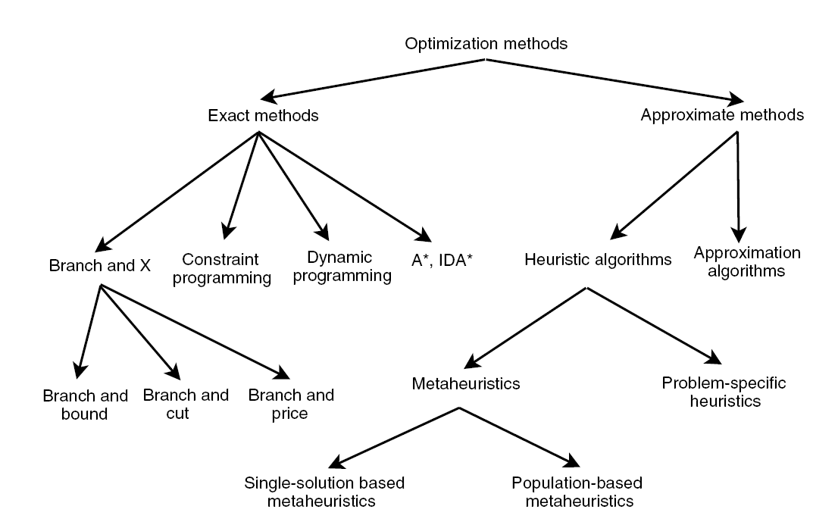
Existing Approaches
Exact Approaches
Search the whole solution space
Optimal solution is always found
Meta-heuristics
General-purpose algorithmic designed to
solve complex optimization problems
Problem-specific heuristics
Tailored algorithm to solve a specific
problem
Notes:
Explicar:
Cada um dos tópicos incluindo informação dos slides à frente removidos
Será feita uma breve explicação do GC quando este for mencionado na abordagem

Slide 7
ITC 2007 Examination track
Composed by 12 different datasets
Solution ranking depends on:
its distance to feasibility and
its own fitness value
Available execution time limit of 221 seconds
computed by the benchmark software for the test hardware
allows to compare different approaches on different software/hardware pairs
Notes:
Explicar:
Este problema no geral (tem as suas próprias hard e soft constraints, objectivo é criar um horário final seguindo as regras de hard constraints….)
Que cada dataset tem diferentes dificuldades (detalhes sobre estes são dados no slide a seguir)
Explicar o benchmarking program
Hard constraints
The hard constraints are the following:
No student must be in more than 1 exam at the same time
Room’s capacity must not be exceeded
Exam’s length must not surpass the assigned time slot’s length
Exams hard constraints must be followed (e.g., 1 AFTER 2)
Rooms hard constraints must be followed (e.g., 1 ROOM_EXCLUSIVE)

Slide 8
Hard (H) and Soft (S) Constraints
(H) No student must be in more than one exam at the same time
(H) Room’s capacity must not be exceeded
(H) Exam’s length must not surpass the assigned time slot’s length
(H) Period related hard constraints (e.g., 1 AFTER 2)
(H) Room related hard constraints (e.g., 1 ROOM_EXCLUSIVE)
(S) Two exams in a row or in a day
(S) Period spread
(S) Mixed durations
(S) Larger exams constraints
(S) Room penalty
(S) Period penalty

Slide 9
Proposed Solution
Examination Timetable
Hill Climbing
Simulated Annealing
Graph Coloring
Loader
ITC 2007 Data
Entities’
repositories
Raw data
Feasible
solution
Improved
solution
Improved
final solution
Notes:
Mencionar oralmente que processamento é realizado em duas fases: criação de uma solução fazivel e posterior optimização desta

Slide 10
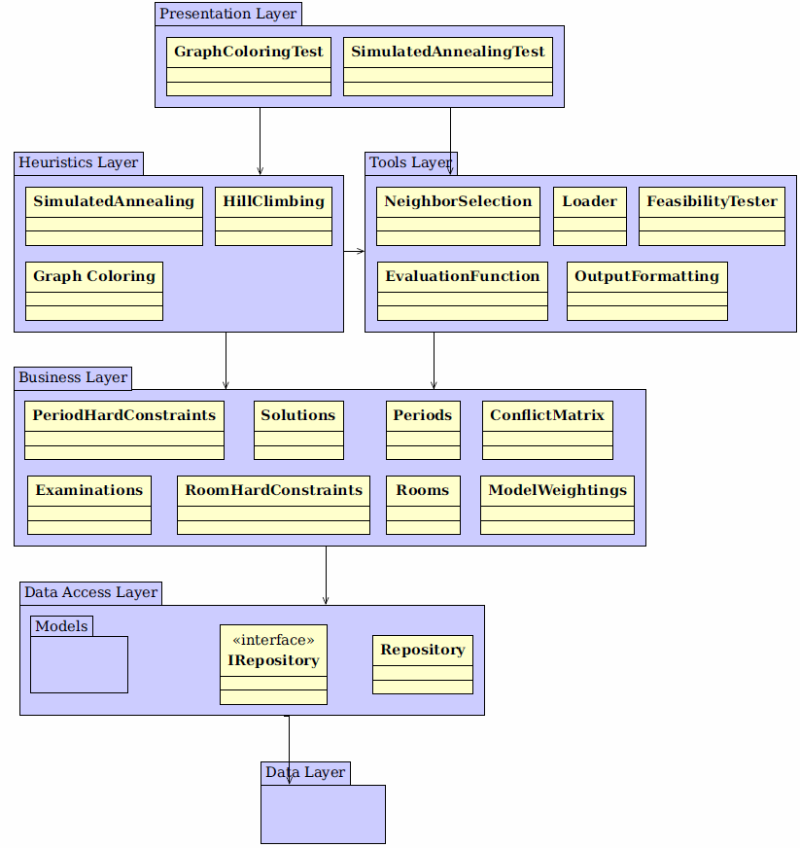
Software Architecture
Data Layer
Stores entities (e.g., Examinations, timeslots)
Data Access Layer
Provides repositories to access the stored entities
Business Layer
Repository handling
Business classes implement the Singleton pattern
Heuristics Layer
Access to the implemented heuristics
Tools Layer
Tools used by the Heuristics Layer and Presentation Layer
Presentation Layer
Notes:
Explicar cada camada separadamente e as suas ligações

Slide 11
Loader
Loads information from the dataset file
Examinations and students’ enrollments
Rooms and their penalties
Periods and their penalties
Period and room hard constraints (optional)
Soft constraints
Creates and populates the conflict matrix
Notes:
Explicar:
Esta tool
O que está presente nos ficheiros dos datasets
Conflict Matrix

Slide 12
Graph Coloring
Generates an initial feasible solution
Largest Degree Ordering method is used
Four sorted assignment lists are used
Unassigned examinations with room exclusivity hard constraint
Unassigned examinations with after hard constraint
Unassigned examinations with examination coincidence hard constraint
All other unassigned examinations
Examination assignment
Normal assignment
Forcing assignment
Assignment Lists
230
110
422
75
621
954
13
755
Timetable
18/04/2005 09:30:00
E: 107 R: 2
E: 202 R: 1
19/04/2005 09:30:00
E: 2 R: 5
20/04/2005 09:30:00
E: 112 R: 6
E: 254 R: 1
Notes:
Explicar:
Primeira heuristica a ser executada
Explicar LDO
Cada fase (com a ajuda da imagem)

Slide 13
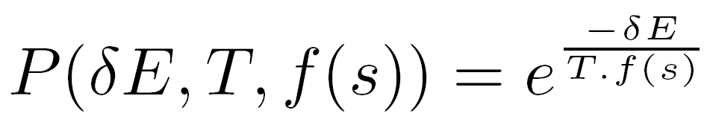
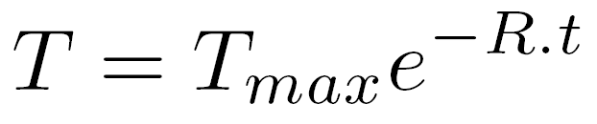
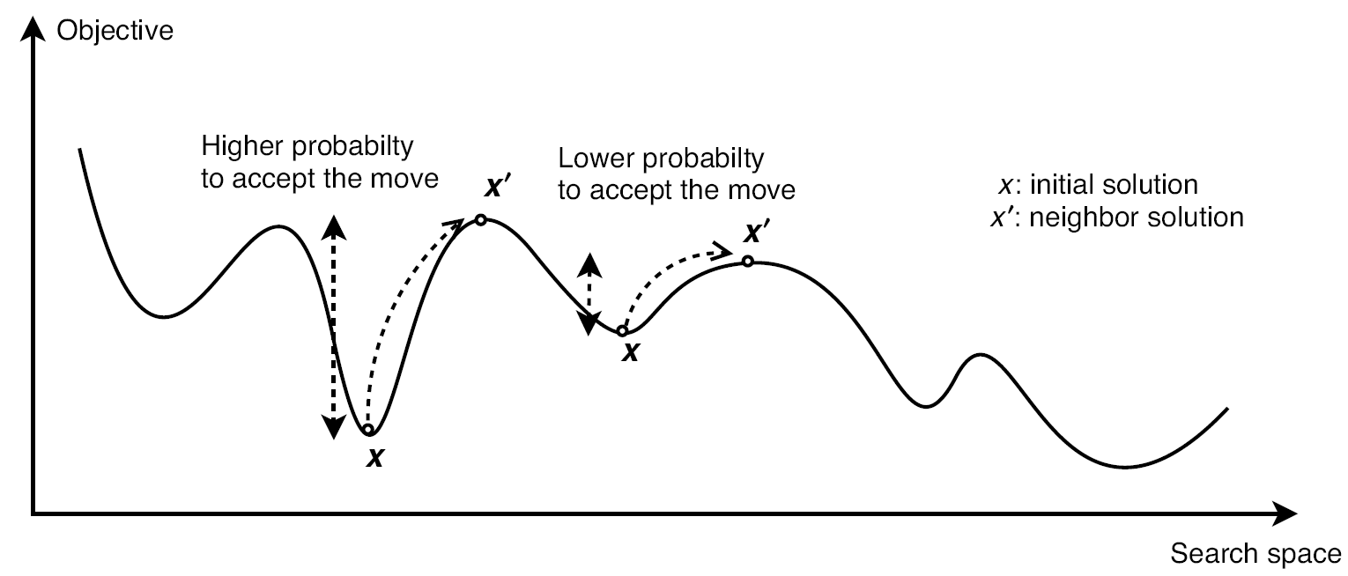
Simulated Annealing (1/2)
Neighbor operators generate neighbor solutions
Neighbor solutions’ acceptance criterion:
Exponential (decreasing) cooling schedule:
Parameters used in this meta-heuristic:
Maximum temperature
Minimum temperature
Number of iterations per temperature value
Temperature decreasing rate
Notes:
Explicar:
Esta heuristic
O que é acceptance criterion
Cooling schedule
Todos os parametros (com ajuda da imagem)

Slide 14
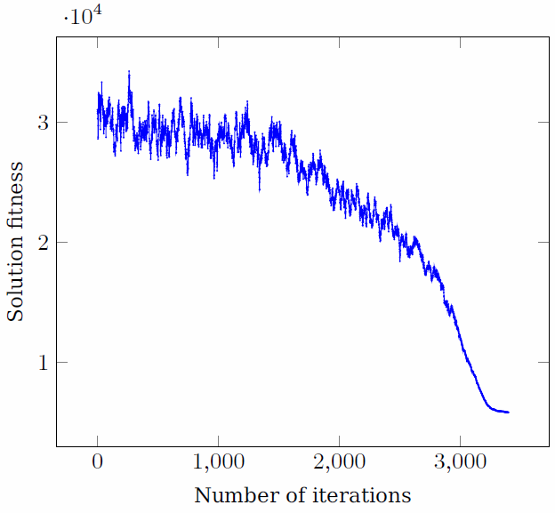
Simulated Annealing (2/2)
Parameters : TMax = 0.1, TMin = 1e-06, loops = 5 and rate = 16e-5
Results:
Notes:
Explicar o porquê deste resultado

Slide 15
Hill Climbing
Executes after SA if it finishes before the time limit
Uses the same neighbor operators as the SA
Only accepts better solutions
It is time-monitored
Yields a slight solution improvement
Notes:
Explicar:
A heurística;
O porquê da utilização desta heurística;
O facto de poder ou não melhorar a solução, depende se já está presente num local óptimo;
É bom que este seja executado, mas por pouco tempo – Significa que o SA conseguiu executar até ao fim e que o HC só lá está para tentar encontrar (dificilmente) uma melhor solução e fazer com o que algoritmo acabe no devido tempo.

Slide 16
Neighborhood Operators
Room Change
Period Change
Period & Room Change
Room Swap
Period Swap
Period & Room Swap
Notes:
Explicar:
Cada operador
Que a escolha é random e que foi implementado outro guiado mas que normalmente tem piores resultados
O ultimo operador foi implementado mas não foi usado – Explicar os testes feitos

Slide 17
Incremental Fitness computation
It relies on a differential computation scheme
The difference between two solutions is computed:
the operations that applied to one solution lead to the other one
Results are obtained 19 times faster, compared to the default (non-incremental) fitness computation

Slide 18
Automatic Rate computation
Guarantees that most of the total available time is used, regardless of the dataset
The computation requires a simulation of the SA algorithm
A new rate is computed for each dataset
Rate is defined (by simulation) as a function of the dataset complexity, using almost the total available time
Higher likelihood of obtaining better results, compared to using a static rate
Notes:
Mencionar que com um rate estático não é garantido que um set de parâmetros seja bom para todos os datasets, já que em uns o algoritmo corre mais rapidamente que outros devido à sua dificuldade.

Slide 19
Experimental Results (1/4)
Average fitness values of 10 runs for each dataset
SA parameters:
TMax = 0.1
TMin = 1e-06
reps = 5
rate = computed automatically

Slide 20
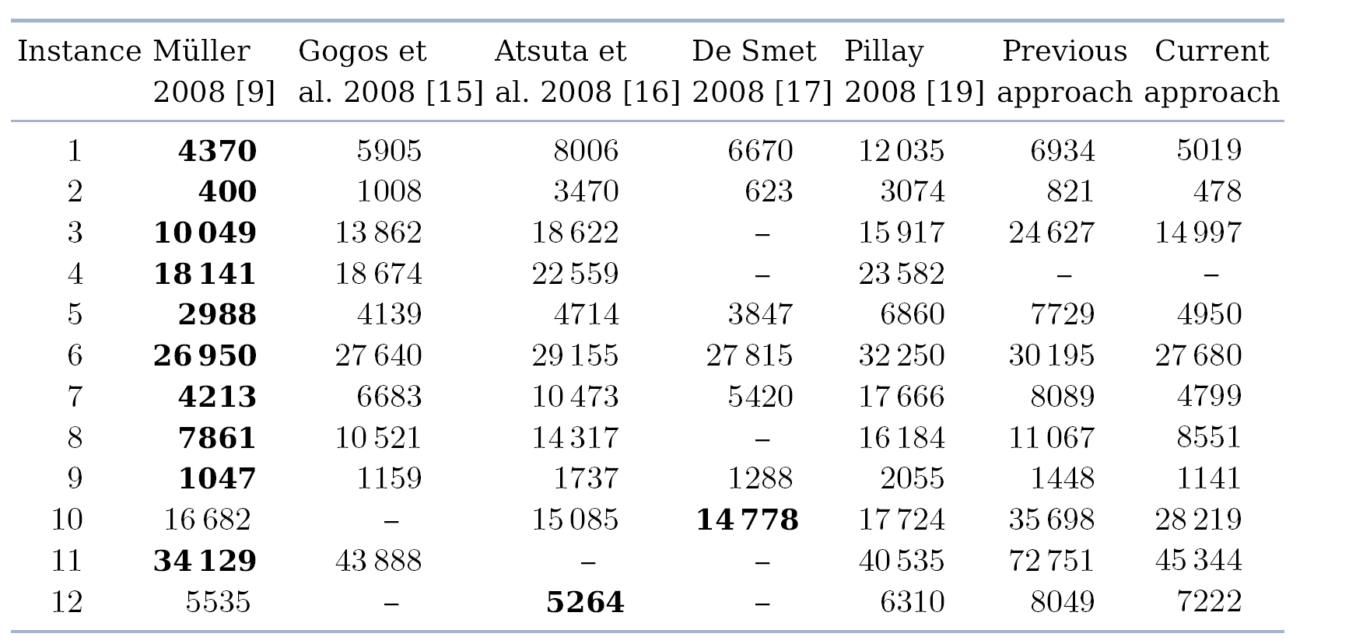
Experimental Results (2/4)
Notes:
Explicar:
Que foi possível em alguns datasets obter resultados que são comparaveis aos 5 vencedores;
Que a previous approach não tinha rate automático nem calculo de fitness incremental;
etc.

Slide 21
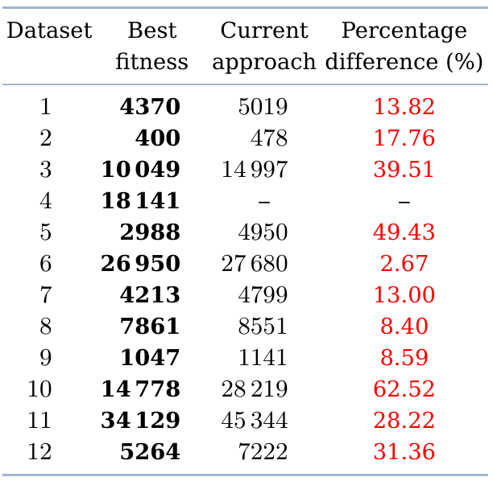
Experimental Results (3/4)

Slide 22
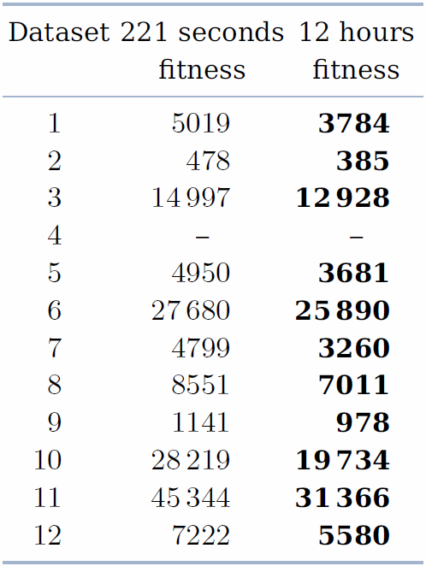
Experimental Results (4/4)
Notes:
Explicar:
- Diferença da qualidade dos resultados com e sem a restrição temporal; a ideia aqui é ver, em que medida a constrição temporal é muito forte para este problema.

Slide 23
Conclusions
A program to generate timetables following ITC2007 rules, using heuristics:
Graph Coloring heuristic - yields a feasible solution
Simulated Annealing and Hill Climbing meta-heuristics - improve on the initial feasible solution
Hill Climbing as the final stage, assures the fulfilment of the limit time constraint
For some datasets, our results were close to those of Müller

Slide 24
Future Work
Development of different approaches
Modifications to the GC technique to generate feasible solutions for the dataset 4
Modifications to the operators to move two examinations at the same time
Notes:
Explicar:
Desenvolver novas abordagens, por exemplo, adicionar o Great Deluge à abordagem actual;
Mover dois exames ao mesmo tempo para poder mover exames com examination_coincidence, melhorando a pesquisa da heurística no espaço de soluções

Slide 25
Tools and Techniques
Developed using .NET
C# Programming Language
Visual Studio 2013 as the development tool
ReSharper extension

Slide 26
The End
I hope you have enjoyed!
Any questions, please?

